Slide 1
Q&A 2 SQL
PD Track

Slide 2
SSN | Name | Dno
1 | Aly | 10
2 | Mohamed | 10
3 | Asmaa | 20
4 | Mahmoud | 30
5 | Mona | 20
6 | Mona | 20
Distinct
Index
Join
Group by and having
View (with check options)
Multiple row operator (in, all, any)
Display department number → employees
Select distinct (dno)
From employee;
Dno
10
20
30
Name | Dno
Aly | 10
Mohamed | 10
Asmaa | 20
Mahmoud | 30
Mona | 20
Select distinct (name, dno)
From employee;

Slide 3
SSN | Name | Salary | Dno
1 | Aly | 1200 | 10
2 | Mohamed | 3000 | 10
3 | Asmaa | 1500 | 20
4 | Mahmoud | 2500 | 30
5 | Mona | 2800 | 20
6 | Mona | 3500 | 20
Distinct
Multiple row operator (in, all, any)
Index
Join
Group by and having
View (with check options)
From
Where
Select
Order by
Select *
From employee
Where dno in (10, 20)
Order by name ASC, salary DESC;
SSN | Name | Salary | Dno
1 | Aly | 1200 | 10
3 | Asmaa | 1500 | 20
4 | Mahmoud | 2500 | 30
2 | Mohamed | 3000 | 10
6 | Mona | 3500 | 20
5 | Mona | 2800 | 20

Slide 4
SSN | Name | Salary | Dno
1 | Aly | 1200 | 10
2 | Mohamed | 3000 | 10
3 | Asmaa | 1500 | 20
4 | Mahmoud | 2500 | 30
5 | Mona | 2800 | 20
6 | Mona | 3500 | 20
Distinct
Multiple row operator (in, all, any)
Index
Join
Group by and having
View (with check options)
From
Where
Select
Order by
Select *
From employee
Order by dno ASC, salary DESC;
SSN | Name | Salary | Dno
2 | Mohamed | 3000 | 10
1 | Aly | 1200 | 10
6 | Mona | 3500 | 20
5 | Mona | 2800 | 20
3 | Asmaa | 1500 | 20
4 | Mahmoud | 2500 | 30

Slide 5
Topics
Order by (more than one column)
Delete P.K. when there is F.K related to it.
Delete from employee where fname=‘kamel’ and lname=‘Mohamed’
Delete, truncate, drop
Alter, update
Select, Join
Nested sql (sub query)
Having & where
Group By
Aggregate function
Views

Slide 6
Product_name | Cost/unit | Expire date
Cheese | 35 | 10/3/2022
Cheese | 50 | 30/12/2021
Milk | 6 | 30/11/2021
Yoghurt | 7 | 3/12/2021
Select product_name, Cost/unit, Expire Date
From products
Order by product_name Asc, Cost/unit ASC

Slide 7
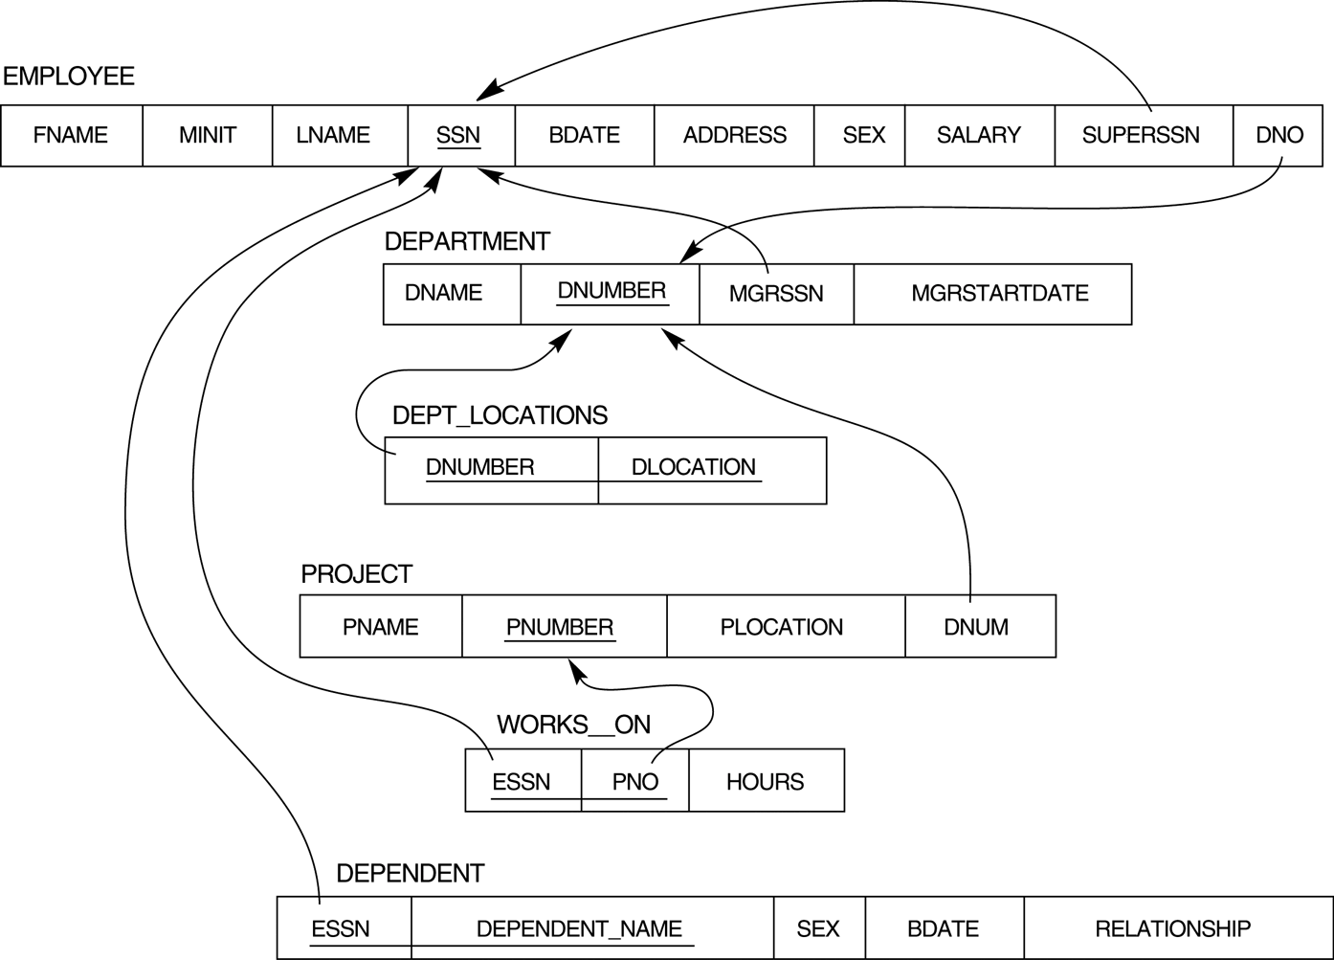
Manage
work

Slide 8
Create database companySD;
Use companySD;
Create table employee (SSN number (10) primary key, fname char (10), lname varchar (10), superSSN number (10));
Alter table employee add constraint foreign key superSSN references employee (SSN);
F.K.
Employee
SSN
Fname
Lname
SuperSSN
SSN | Fname | Lname | SuperSSN
10 | Ahmed | Mahmoud
20 | Mona | Ali | 10
30 | Asmaa | Mohamed | 10
40 | Mohamed | Ali | 20
Create table dependent (ESSN number (10) foreign key references employee (SSN), dependent_name char (20),
Bdate date, relationship char (10), primary key (ESSN, dependent_name));
Restricted relationship → error in delete or update
Delete from employee where SSN = 10;
Update employee
Set SSN=100 where SSN =10;

Slide 9
Create database companySD;
Use companySD;
Create table employee (SSN number (10) primary key, fname char (10), lname varchar (10), superSSN number (10));
Alter table employee add constraint foreign key superSSN references employee (SSN);
F.K.
Employee
SSN
Fname
Lname
SuperSSN
SSN | Fname | Lname | SuperSSN
10 | Ahmed | Mahmoud
20 | Mona | Ali | 10
30 | Asmaa | Mohamed | 10
40 | Mohamed | Ali | 20
Create table dependent (ESSN number (10) foreign key references employee (SSN), dependent_name char (20),
Bdate date, relationship char (10), primary key (ESSN, dependent_name));
Cascade update/delete
Delete from employee where SSN = 10;
SSN | Fname | Lname | SuperSSN
40 | Mohamed | Ali | 20

Slide 10
Create database companySD;
Use companySD;
Create table employee (SSN number (10) primary key, fname char (10), lname varchar (10), superSSN number (10));
Alter table employee add constraint foreign key superSSN references employee (SSN);
F.K.
Employee
SSN
Fname
Lname
SuperSSN
SSN | Fname | Lname | SuperSSN
10 | Ahmed | Mahmoud
20 | Mona | Ali | 10
30 | Asmaa | Mohamed | 10
40 | Mohamed | Ali | 20
Create table dependent (ESSN number (10) foreign key references employee (SSN), dependent_name char (20),
Bdate date, relationship char (10), primary key (ESSN, dependent_name));
Cascade update/delete
Update employee
Set SSN=100 where SSN =10;
SSN | Fname | Lname | SuperSSN
100 | Ahmed | Mahmoud
20 | Mona | Ali | 100
30 | Asmaa | Mohamed | 100
40 | Mohamed | Ali | 20

Slide 11
Create database companySD;
Use companySD;
Create table employee (SSN number (10) primary key, fname char (10), lname varchar (10), superSSN number (10));
Alter table employee add constraint foreign key superSSN references employee (SSN);
F.K.
Employee
SSN
Fname
Lname
SuperSSN
SSN | Fname | Lname | SuperSSN
10 | Ahmed | Mahmoud
20 | Mona | Ali | 10
30 | Asmaa | Mohamed | 10
40 | Mohamed | Ali | 20
Create table dependent (ESSN number (10) foreign key references employee (SSN), dependent_name char (20),
Bdate date, relationship char (10), primary key (ESSN, dependent_name));
Delete Nullifies
Delete from employee where SSN =10;
SSN | Fname | Lname | SuperSSN
20 | Mona | Ali
30 | Asmaa | Mohamed
40 | Mohamed | Ali | 20

Slide 12
Delete record of P.K. when there is F.K related to it.
Relationship (referential integrity constraint)
1- Restricted (No action) update or delete all F.K. that use this P.k.
Then delete record of P.K.
2- Cascade
Update/Delete cascade
Delete record of P.k. then delete all records that use this P.K.
3- Nullifies
Delete record of P.K. then set F.k. to null

Slide 13
Create table Department (Dum number (5) primary key, Dname varchar (20) unique)
Department
Dnum
Dname
MgrSSN
Create table employee (SSN number (10) primary key,
fname char (10), lname varchar (10),
Dno number (5) foreign key reverences department (Dnum));
Create table employee (SSN number (10) primary key,
fname char (10), lname varchar (10),
Dno number (5),
CONSTRAINT fk_emp_dep foreign key (Dno)
References department (dnum)
On delete nullifies on update restricted);
Alter table employee drop constraint fk_emp_dep;
Alter table employee add constraint fk_emp_dep;
Drop table employee;

Slide 14
SQL
SSN | Fname | Lname | SuperSSN
10 | Ahmed | Mahmoud
20 | Mona | Ali | 10
30 | Asmaa | Mohamed | 10
40 | Mohamed | Ali | 20
DDL (create, alter, drop, truncate)
DML (insert, update, delete) (log files)
DCL (grant, revoke) //grant all on employee, department to ahmed;
//revoke select on employee from Ahmed;
DQL (select)
Create database intake43
Use intake 43
Create table employee (fname, lanme, salary, SSN, Dno)
Insert into employee values (NULL, NULL, NULL, 12354, 20);
Update employee set fname=‘aly’ and lname=‘ahmed’ and superssn=124566 where SSN=12345;
Update employee set Dno=30 where SSN =12345;
Delete from employee where ssn=12345;
Update employee set superSSN=40 where superSSN =10
Delete from employee where SSN = 10
SSN | Fname | Lname | SuperSSN
20 | Mona | Ali | 40
30 | Asmaa | Mohamed | 40
40 | Mohamed | Ali | 20
Update employee
Set superssn = null
Where SSN = 20

Slide 15
Objects
Database
(meta data+ stored Data)
Tables (student, course, instructor, evaluation ….)
Views
Indexes
Stored procedure
….
Users
DBA
Developers
Ahmed
Aly
Staff
Students
Grant insert on student to students;
Grant insert on evaluation to students;

Slide 16
Create table
Create table dependent (ESSN number(14) , Dependent_name varchar(30), Bdate date, gender char (1) not null,
Foreign key ESSN references employee (SSN),
Primary key (ESSN, Dependent_name));
/////////////////////////////
Create table dependent (ESSN number(14) , Dependent_name varchar(30), Bdate date, gender char (1) not null,
CONSTRAINT PK_Dependent PRIMARY KEY (ESSN, Dependent_Name));
Alter table dependent add CONSTRAINT FK_Dependent Foreign key ESSN references employee (SSN) ON DELETE CASCADE ON UPDATE RESTRICTED
Alter constraint FK_Dependent ………………

Slide 17
Delete, truncate, drop
Delete is DML Commit or rollback
Where
Truncate is DDL auto commit
Delete and truncate
Drop delete table with structure
Drop table dependent;
Select * from dependent;//table not exist
rollback

Slide 18
Alter, update Alter update in structure (add column, remove column, rename of column, datatype, constraints, …etc.) Update in data

Slide 19
join
SSN | Name | Salary | Dno
1 | Aly | 1200
2 | Mohamed | 3000 | 10
3 | Asmaa | 1500 | 20
4 | Mahmoud | 2500
5 | Mona | 2800 | 20
6 | Mona | 3500 | 20
From
Where
Select
Order by
Select fname, lname , dno
From employee
Where salary>2000
-----------------------------------
Select fname, lname , dname
From employee, department
Where dnum = dno
OR
Select fname, lname , dname
From employee inner join department
On dnum = dno
-------------------------
Outer join
Select fname, lname , dname
From employee full outer join department
On dnum = dno
Cross join or Cartesian product
Select fname, lname , dname
From employee, department
N*M
Dnum | Dname
10 | IT
20 | Marketing
30 | Sales

Slide 20
Employee
SSN
Fname
Dno
superSSN
Department
Dnum
Dname
Display employee name, project name
Select e.fname, p.pname
From employee e, project p, works_on w
Where e.SSN = w.ESSN
And p.Pnumber = w.Pno
----------------------------------------------------
Display project name, department name
Select d.dname, p.pname
From department d, project p
Where d.dnum = p.dnum
Works_ON
ESSN
Pno
hours
Project
Pnumber
Pname
dnum
Display employee name and department (work)
Select fname, dname
From employee, department
Where dnum=dno
-----------------------------------------------------------------
Display department name, manger name (manage)
Select fname, dname
From employee, department
Where SSN=MgrSN

Slide 21
Manage
work

Slide 22
Subquery
join
Display dname for department, its employees salary>2000
Select dname
From department, employee
Where salary>2000
And dnum=dno
Subquery
Outer query (inner query)
Select dname, salary
From department
Where dnum in (select dno from employee where salary > 2000 and dname = ‘IT”)
Inner query from, where, select
Outer query from, where, select

Slide 23
Select, Join
1- from
2- where
3- select
4- order by
Select * from employee where salary>2000 and gender =‘M’ order by fname;
Select * from employee where fname =“aly”;
Select * from employee where fname like “a%”;
Select * from employee where dno =20 or dno =30;
Select * from employee where dno in (20, 30);

Slide 24
Select (try)
1- from
2- where
3- select
4- order by
Select * from employee where salary=1000 or salary=2000 or salary=3000;
Select * from employee where salary in (1000, 2000, 3000);
Select * from employee where salary between 1000 and 2000;

Slide 25
Try
Select * from employee where salary in (1000, 2000, 3000);
Select * from employee where salary > all (1000, 2000, 3000);
Select * from employee where salary > any (1000, 2000, 3000);

Slide 26
Select (Try)
1- from
2- where
3- select
4- order by
Select * from employee where (salary=1000 or salary=2000 or salary=3000) and fname=“aly”;
///Not, or, and → priority of operation
Display all employees except working in department 10 and 20
Select *
from employee
Where dno not in (10, 20);

Slide 27
Join
DBMS
1- from
2- where
3- select
Select from more than one table
Display employee name and department name (work)
Select fname, lname, dname
From employee, department
Where Dnumber=dno; //work relationship
Select fname, lname, dname
From employee, department
Cartesian Product
m*n

Slide 28
Inner join
Select fname, lname, dname
From employee, department
Where Dnumber=dno;
/////
Select fname, lname, dname
From employee inner join department
On Dnumber=dno;

Slide 29
Ambiguous error
Select employee.fname, employee.lname, project.pname
From employee, works_on, project
Where works_on.SSN=employee.SSN
And works_on.Pno=project.pnumber;

Slide 30
Alias for table
Employee name, project name
Select e.fname, e.lname, p.pname
From employee e, works_on w, project p
Where w.SSN=e.SSN
and w.Pno=p.pnumber;
//////////
select e.fname, e;lname, p.pname
from employee e inner join works_for w
on w.essn=e.ssn
inner join project p
on p.pnumber = w.pno;

Slide 31
Employee (SSN, name, address, dno)
Department(Dnum, name, MgrSSN)
Manager name, department name
Select e.name, d.name
From employee e, department d
Where SSN=mgrSSN;

Slide 32
Nested sql (sub query)
Inner query
1- from
2- select
Outer Query
1-from
2- where
3- select
Employees who have no dependents by using sub query
Select *
From employee
Where SSN not in (select ESSN
from dependent)
Employees who have no dependents by using join
Select *
From employee, dependent
Where SSN=ESSN
Select *
From employee
Where (select ESSN
from dependent)

Slide 33
Select *
From employee e
Where SSN not in (select ESSN
from dependent
where e.gender=‘f’)

Slide 34
Sub query
Manager name who manage departments
Select fname, lname
From employee
Where SSN in (select mgrSSN from departments)
Employee name who work in department
Select fname, lname
From employee
Where dno in(select dnum from department)
And salary>2000

Slide 35
Employee name who work in department
Select fname, lname
From employee
Where dno is not null;

Slide 36
Aggregate function
Sum, avg, min, max, count
Select count(*), max(salary), min(salary), avg(salary), sum(salary) from employee;
Select count(*), max(salary), min(salary), avg(salary), sum(salary)
from employee
Where dno in (10, 20) and address like “a*”;
Count(*) | Max(salary) | Min(salary) | Avg(salary) | Sum(salary)
100 | 20000 | 2000 | 5000 | 15000000
Count(*) | Max(salary) | Min(salary) | Avg(salary) | Sum(salary)
40 | 15000 | 2500 | 3000 | 15424550

Slide 37
Display number of employees for each department
Select dno, count (*) AS [number of employees per department]
From employee
Group by dno
Dno | number of employees per department
10 | 20
30 | 15
20 | 30

Slide 38
Display number of employees for each department for employees with salary > 2000
Select dno, count (*) AS [number of employees per department]
From employee
Where salary > 2000
Group by dno
Dno | number of employees per department
10 | 15
30 | 10
20 | 20

Slide 39
Display department name and number of employees for each department for employees with salary > 2000
Select dno, dname, count (*) AS [number of employees per department]
From employee, department
Where salary > 2000
And dnum=dno
Group by dno, dname
Dno | Dname | number of employees per department
10 | IT | 15
30 | Sales | 10
20 | Marketing | 20

Slide 40
Display department name and number of employees for each department for employees with salary > 2000
and number of employees greater than 10
Select dno, dname, count (*) AS [number of employees per department]
From employee, department
Where salary > 2000
And dnum=dno
Group by dno, dname
Having count (*)>10
Order by dno;
Dno | Dname | number of employees per department
10 | IT | 15
20 | Marketing | 20
1- from
2- where
3- group by
4- having
5- select
6- order by

Slide 41
Aggregate
1- from
2- where
3- group by
4- having
5- select
6- order by
number of employees in each department and department name
Any columns beside the aggregate function in select must be used in group by
Select dno, dname, count(*)
From employee, department
Where dno=dnum //join
And dno in (10,20)
Group by dno, dname
Having count(*)>20;
Dno | Dname | Count
20 | Marketing | 30

Slide 42
Examples
Display department name with the highest paid employee
Select dname
From department
Where dnum in
(select dno from employee
where salary in (select max(salary) from employee))

Slide 43
Example
Find the names of employees whose salary is greater than the salary of the employees in department 5
Select fname, lname
From employee
Where salary>all (select salary from employee where dno=5)
============= (the same)
Select last_name, fname
from employee
where salary > (select max ( salary ) from employee where dno=5);

Slide 44
EXIST
SELECT *
FROM customers
WHERE EXISTS
(SELECT *
FROM orders
WHERE customers.customer_id = orders.customer_id);

Slide 45
SQL
Logical schema
Query → understand (display, update, insert , delete)
Select (aggregate function)
Select dno, sum(salary)
From employee; //generate error
Select dno, sum(salary)
From employee
Group by dno;
Select dno, dname, sum(salary)
From employee, department
Where dnum=dno
Group by dno, dname

Slide 46
Grant select on employee to ahmed;
Ahmed> select * from employee;
View
Create view vw_employee_personalData
AS
(select SSN, fname, lname, address, Bdate from employee);
Grant select, insert on vw_employee_personalData to ahmed;
Ahmed> select * from vw_employee_personalData;
---------------------------------------------------------------------------------------

Slide 47
View: updatable?
Insert into vw_employee_personalData values (……..)

Slide 48
Views is logical not physical
Create view vw_employee
As (select fname, lname, salary from employee);
Select * from vw_employee;
Grant select, insert to ahmed on vw_employee;
Create view vw_emp_proj
AS (select e.fname, e;lname, p.pname
from employee e inner join works_for w
on w.essn=e.ssn
inner join project p
on p.pnumber = w.pno)
Select * from vw_emp_proj;

Slide 49
View is updatable?
A view is not updatable :
1- based on multiple tables
2- defined using grouping and aggregate functions
3- not have primary key and not null columns
Create view vw_department as (select dname, mgrSSN);
Insert into vw_department value (“DP100”, 1234);

Slide 50
Index
Search
Employee (SSN, fname, lname, ……)
Index on fname
Select * from employee where Fname like “M%”
Sort asc by fname
Binary search

